Slide 1
Measuring the Variability in Estimates: Point Estimates

Slide 2
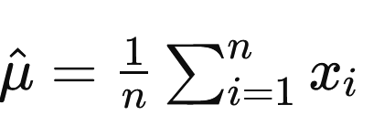
Point Estimates
A point estimate is a single value that serves as the best guess for a population parameter.
Common point estimators:
Mean (for the population mean, μ):

Slide 3
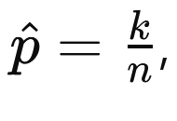
Proportion (for the population proportion, p):
where k is the number of successes in a sample.

Slide 4
Properties of Point Estimates
Unbiasedness: The expected value of the estimator is equal to the true population parameter. If E[θ^] =0 the estimator is unbiased.
Consistency: As the sample size increases, the estimator converges to the true population parameter.
Efficiency: Among all unbiased estimators, an efficient estimator has the smallest variance.
Sufficiency: An estimator is sufficient if it uses all the information in the sample that is relevant to the parameter being estimated.

Slide 5
Variability in Point Estimates
Sampling variability refers to the fact that different samples from the same population may yield different estimates.
Key factors affecting variability:
Sample Size: Larger samples reduce variability in the estimate.
Population Variability: Higher variability in the population leads to greater variability in the point estimates.

Slide 6
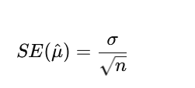
Standard Error of an Estimator
The standard error (SE) measures the variability of the sample statistic (e.g., sample mean) as an estimate of the population parameter. It quantifies how much we expect the point estimate to vary from one sample to another.
For the sample mean:
Where σ the population standard deviation, and n is the sample size.

Slide 7
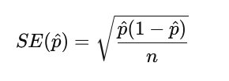
For the sample proportion:
P^= No. of successes / total population
Interpretation of SE:
Smaller SE means more precise estimates.
SE is directly related to the variability of the population and inversely related to the sample size.

Slide 8

Example 1: Estimating the Mean Height of a Population
Suppose we sample 50 individuals and calculate the mean height as 170 cm. The standard deviation of heights in the population is 10 cm.
Point Estimate of the Population Mean (μ^​):
= 170 cm
Calculate the S.E ( Standard Error)
Interpretation: Based on this sample, we estimate that the average height of the population is 170 cm, and the standard error of this estimate is 1.41 cm. This suggests that if we repeated the study, the estimated mean height would typically vary by around 1.41 cm from sample to sample.

Slide 9

Example 2: Estimating a Proportion
Suppose in a survey of 200 people, 120 people say they prefer online shopping.
Calculate Point Estimate for the Proportion (p^​):
120/200= 0.60
Calculate the Standard Error (SE):
Interpretation: We estimate that 60% of the population prefers online shopping, and the standard error of this estimate is about 3.47%.

